Slide 1
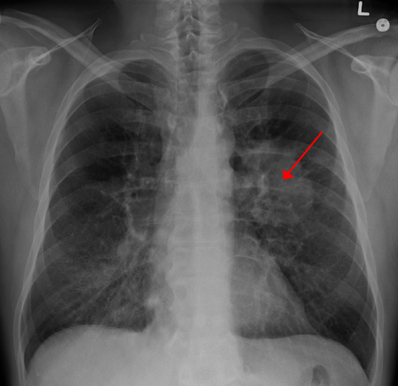
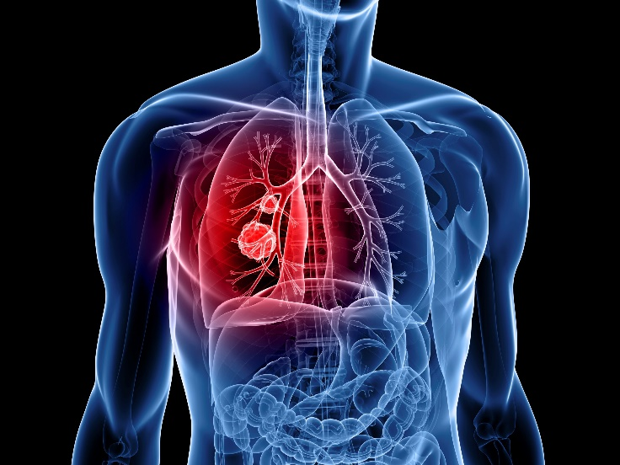
Lung Cancer Prediction using Deep Learning
Pattern Recognition (BRI 623)
Term Project
2017. 06. 14. Wed.
Team 7
Kim, Junho (2016021307)
Lee, Seung-Bo (2015011167)
Khan, Mohammad Azam (2016010936)

Slide 2
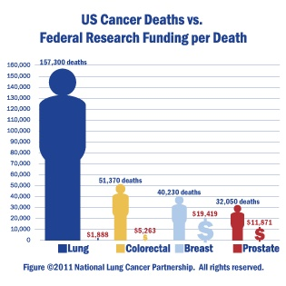
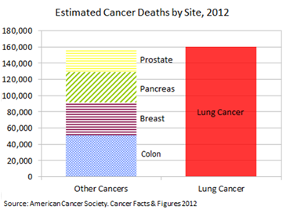
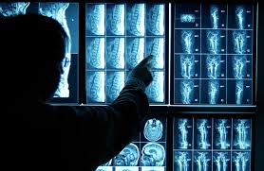
1. Research Topic [1/2]
Topic : Lung cancer prediction using Deep Learning
Why is it important to predict the lung cancer with deep learning?
Background
1. High rate of lung cancer death
2) Reduce health cost
3) Mistake of radiologist

Slide 3
1. Research Topic [2/2]
Topic : Lung cancer prediction using Deep Learning
automatic learning to differentiate
Cancerous lung (1) and Non-cancerous lung (0) patterns
using Deep Learning
Details
Nodule candidates detection
Nodule segmentation
Blob detection
False Positive reduction
Malignancy prediction (Classification)
And so on..

Slide 4
2. Goal, Challenge and Strategy
Detecting lung nodules
In automated fashion
Reduce manual intervention
Prediction
Is this CT scan is of a patient having/will develop cancer ?
Challenges
Publicly available data set is Limited
Domain expertise
Strategy
Use of Deep Neural Network (DNN)
Convolutional Neural Network (CNN)

Slide 5
3. Existing Systems
Early Lung Cancer Action Project (ELCAP)
lowdose spiral CT detects lung cancer in early stages
conventional chest radiograph
Statistical probability from CT-detected pulmonary nodules to lung cancer
Small nodules are not predictive for lung cancer
Immediate diagnostic evaluation is necessary for large nodule
# of nodules more than a certain size is correlated with lung cancer probability
Support Vector Machines (SVMs)
Artificial Neural Networks (ANN)

Slide 6
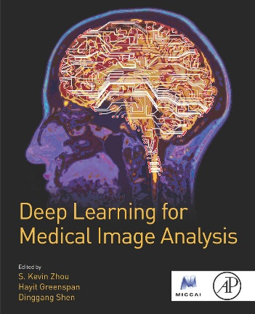
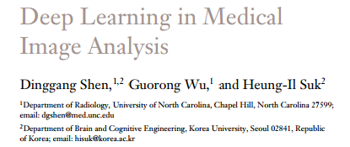
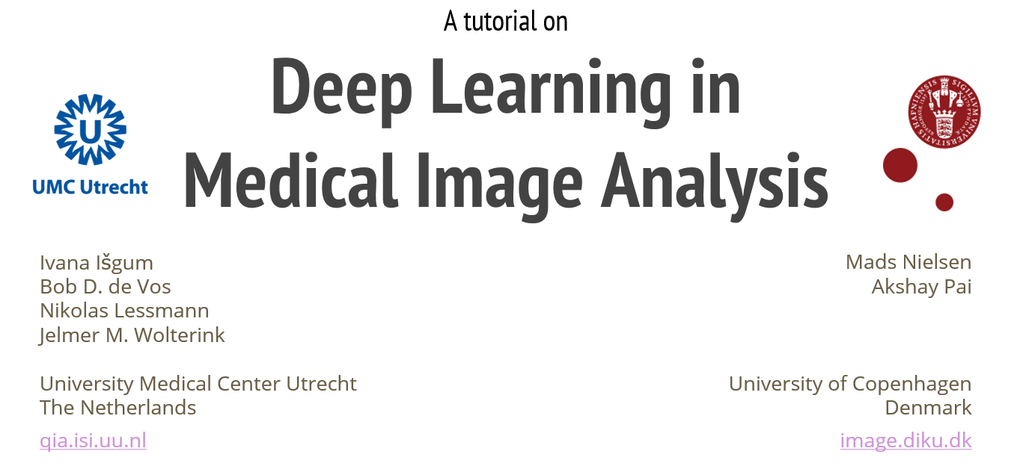
4. Medical Image Analysis for Deep Learning
Fast evolving field
Computer-aided Detection
Computer-aided Diagnosis
Special Mention
Book: Deep Learning for Medical Image Analysis
By S. Kevin Zhou, Dinggang Shen, Hayit Greenspan
Review: Annual Review of Biomedical Engineering
Deep Learning in Medical Image Analysis
Prof. Dinggang Shen and Prof. Guorong Wu
University of North Carolina, Chapel Hill, North Carolina 27599
Prof. Heung-Il Suk,
Department of Brain and Cognitive Engineering, Korea University, Seoul 02841, Republic of Kore
Applications in Medical Imaging
A Tutorial on Deep Learning in Medical Image Analysis
University Medical Center Utrecht, The Netherlands
University of Copenhagen, Denmark

Slide 7
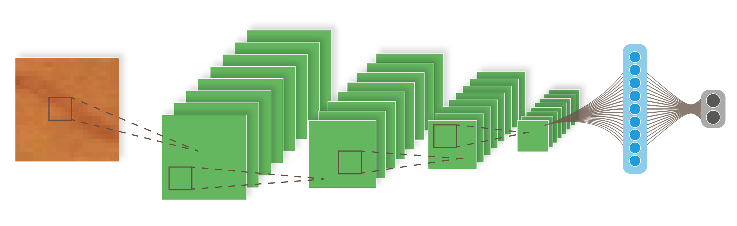
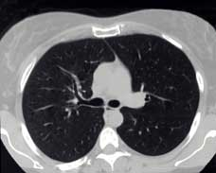
5. Convolutional Neural Network
Recently very successful in computer vision tasks
Increasingly used in analysis of medical images
Proposed Model
FC8: 512
Dropout
Output
Input Image (50x50)
C1: 50x50x32
S2: 25x25x64
C3: 25x25x64
C4: 25x25x128
S5: 25x25x256
F7:
Data set
Lung Image Database Consortium and Infectious Disease Research Institute [(LIDC/IDRI) data base]
reformatted version available for Lung Nodule Analysis 2016 (LUNA16 )
888 CT scans, each has dimensions of 512 x 512 x n, (n = # of axial scans).
About 200 images in each CT scan.
with annotations describing coordinates and ground truth label
Imbalanced dataset
Our approach:
Data Augmentation

Slide 8
6. Results and Evaluation Metrics
Data division (5 fold cross validation)
Train & Validation data
Test data
1 fold
2 fold
3 fold
4 fold
5 fold
Test
Cross validation, sometimes called rotation estimation, is a model validation technique for assessing how the results of a machine learning analysis will generalize to an independent data set
4 fold for train and 1 fold for validation

Slide 9
6. Results and Evaluation Metrics
 | Positive | Negative
Total case | 1351 | 549714
After Down Sampling | 1351 | 5497
After Augmentation | 5404 | 5497
1st fold | 900 | 916
2nd fold | 900 | 916
3rd fold | 900 | 916
4th fold | 900 | 916
5th fold | 900 | 916
Test | 904 | 917
In order to solve the problem of data imbalance, we performed down sampling for negative case and augmentation for positive case.

Slide 10
6. Results and Evaluation Metrics
Cross validation result
Valid | 1 | 2 | 3 | 4 | 5
Acc | 96.86 | 95.87 | 96.97 | 92.62 | 98.07
Loss | 0.088 | 0.116 | 0.113 | 0.384 | 0.062
Average accuracy of cross validation is 96.08%!
Final result
Accuracy: 95.61%
Precision: 96.76%
Recall: 96.79%
Specificity: 94.43%
NPV: 94.49%
 |  | Predicted
 |  | No-nodule | nodule
Ground Truth | No-nodule | 866 | 51
 | nodule | 29 | 875

Slide 11
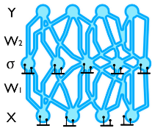
7. Future Directions
Generalization for other medical fields
2D: Cervical cancer
3D: Brain Image
Volumetric CNN
Bayesian Approach
Physicians and others need to understand why a model predicts a specific output.

Slide 12
8. References [1/2]
[1] Bastarrika, Gorka, et al. "Early lung cancer detection using spiral computed tomography and positron emission tomography." American journal of respiratory and critical care medicine 171.12 (2005): 1378-1383.
[2] Horeweg, Nanda, et al. "Lung cancer probability in patients with CT-detected pulmonary nodules: a prespecified analysis of data from the NELSON trial of low-dose CT screening." The Lancet Oncology 15.12 (2014): 1332-1341.
[3] McWilliams A, Tammemagi MC, Mayo JR, Roberts H, Liu G, Soghrati K, Yasufuku K, Martel S, Laberge F, Gingras M: Probability of cancer in pulmonary nodules detected on first screening CT. New England Journal of Medicine 2013, 369(10):910-919.
[4] Armato SG, McLennan G, Bidaut L, McNitt‐Gray MF, Meyer CR, Reeves AP, Zhao B, Aberle DR, Henschke CI, Hoffman EA: The lung image database consortium (LIDC) and image database resource initiative (IDRI): a completed reference database of lung nodules on CT scans. Medical physics 2011, 38(2):915-931.
[5] LeCun, Yann, Yoshua Bengio, and Geoffrey Hinton. "Deep learning." Nature 521.7553 (2015): 436-444.
[6] Roth, Holger R., et al. "A new 2.5 D representation for lymph node detection using random sets of deep convolutional neural network observations." International Conference on Medical Image Computing and Computer-Assisted Intervention. Springer International Publishing, 2014.
[7] Qi, Charles R., et al. "Volumetric and multi-view cnns for object classification on 3d data." Proceedings of the IEEE Conference on Computer Vision and Pattern Recognition. 2016.
[8] Dinggang S, Guorong W, Heung-Il S: Deep Learning in Medical Image Analysis, Annual Review of Biomedical Engineering, Vol. 19, To be printed in August 2017
[9] Litjens, Geert, et al. "A survey on deep learning in medical image analysis." arXiv preprint arXiv:1702.05747 (2017).
[10] Melamed M, Flehinger B, Zaman M, Heelan R, Perchick W, Martini N. Screening for early lung cancer: results of the Memorial Sloan-Kettering study in New York. Chest 1984;86:44–53.

Slide 13
8. References [2/2]
[11] Henschke, Claudia I., et al. "Early Lung Cancer Action Project: overall design and findings from baseline screening." The Lancet 354.9173 (1999): 99-105.
[12] Swensen, Stephen J., et al. "Screening for lung cancer with low-dose spiral computed tomography." American journal of respiratory and critical care medicine 165.4 (2002): 508-513.
[13] Diederich, Stefan, et al. "Screening for early lung cancer with low-dose spiral computed tomography: results of annual follow-up examinations in asymptomatic smokers." European radiology 14.4 (2004): 691-702..
[14] Pastorino, Ugo, et al. "Early lung-cancer detection with spiral CT and positron emission tomography in heavy smokers: 2-year results." The Lancet 362.9384 (2003): 593-597.
[15] Sone, S., et al. "Results of three-year mass screening programme for lung cancer using mobile low-dose spiral computed tomography scanner." British journal of cancer 84.1 (2001): 25..
[16] Sobue, Tomotaka, et al. "Screening for lung cancer with low-dose helical computed tomography: anti-lung cancer association project." Journal of clinical oncology 20.4 (2002): 911-920.
[17] Ost, David, and Alan Fein. "Management strategies for the solitary pulmonary nodule." Current opinion in pulmonary medicine 10.4 (2004): 272-278.
[18] Gould, Michael K., et al. "Cost-effectiveness of alternative management strategies for patients with solitary pulmonary nodules." Annals of internal medicine 138.9 (2003): 724-735.
[19] Nakamura K, Yoshida H, Engelmann R, et al. Computerized analysis of the likelihood of malignancy in solitary nodules with use of artificial neural networks. Radiology. 2000;214:823–830.
[20] Asada N, Doi K, Macmahon H, et al. Potential usefulness of an artificial neural network for differential diagnosis of interstitial lung disease: pilot study. Radiology. 1990;177:857–860.

Slide 14

Thank you !
Any Questions ?

